Slide 1


Company_SD
Database analysis using sql server

Slide 2
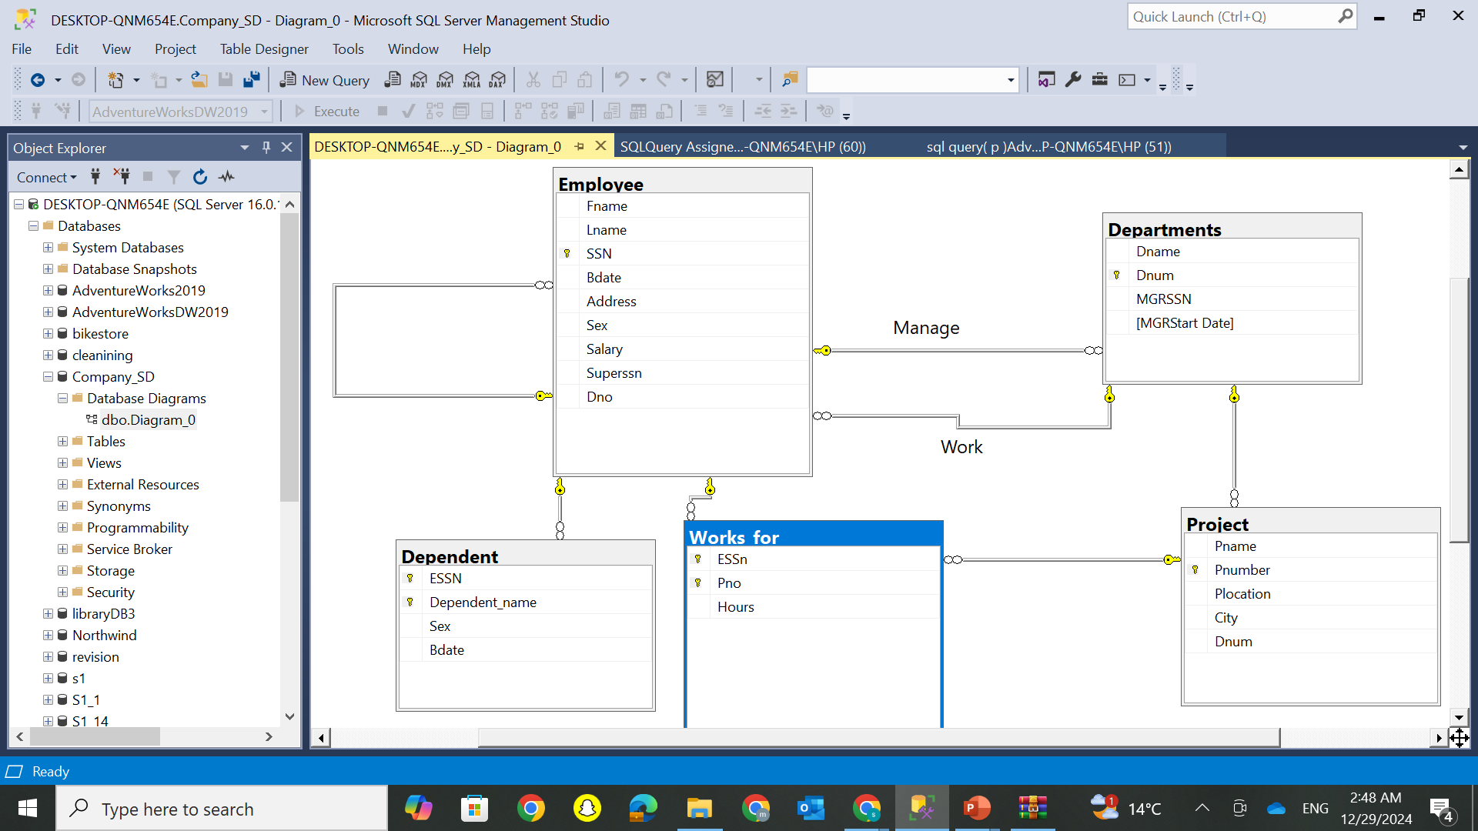
Diagram Company_SD

Slide 3
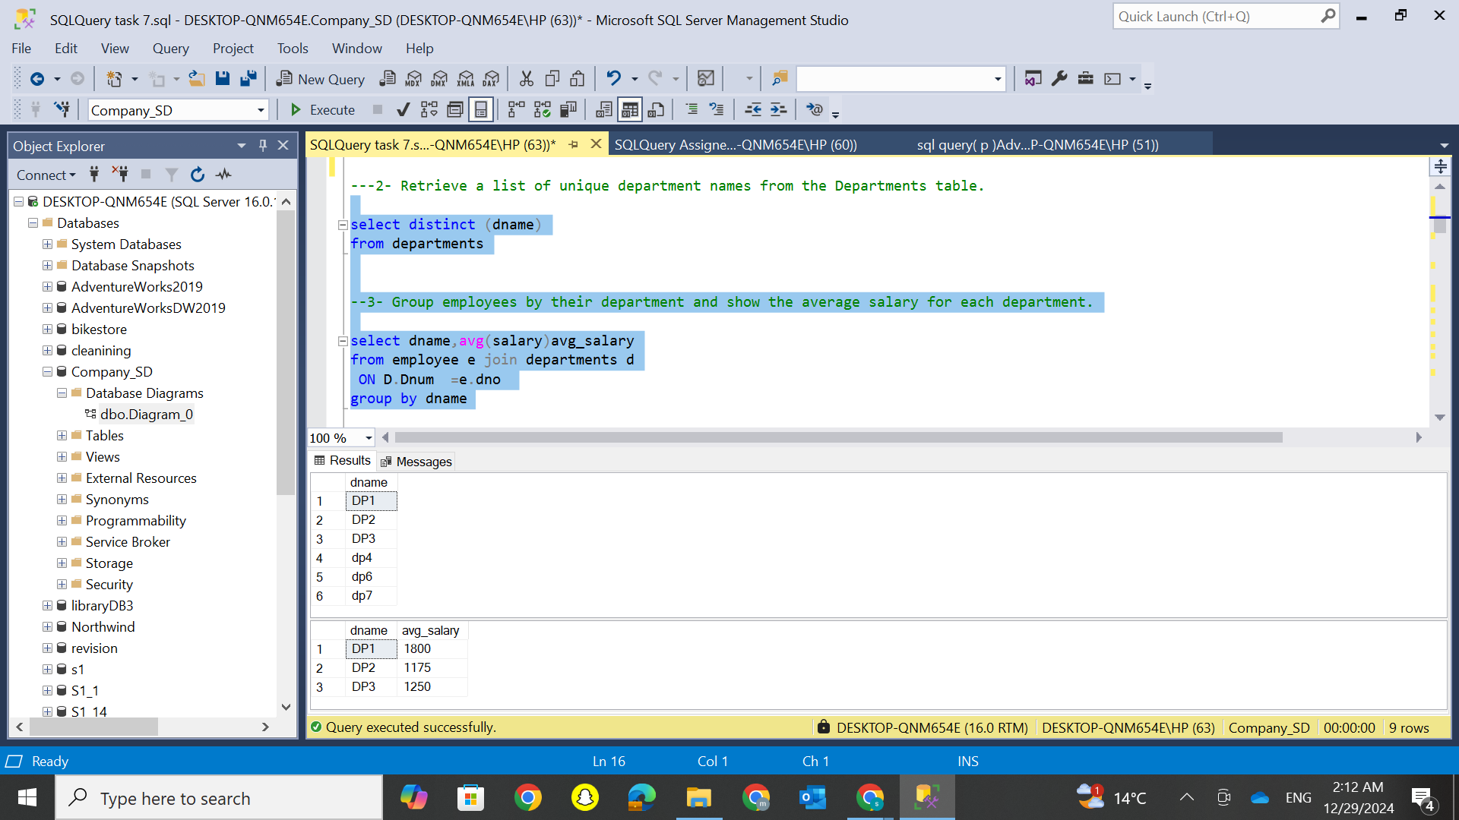
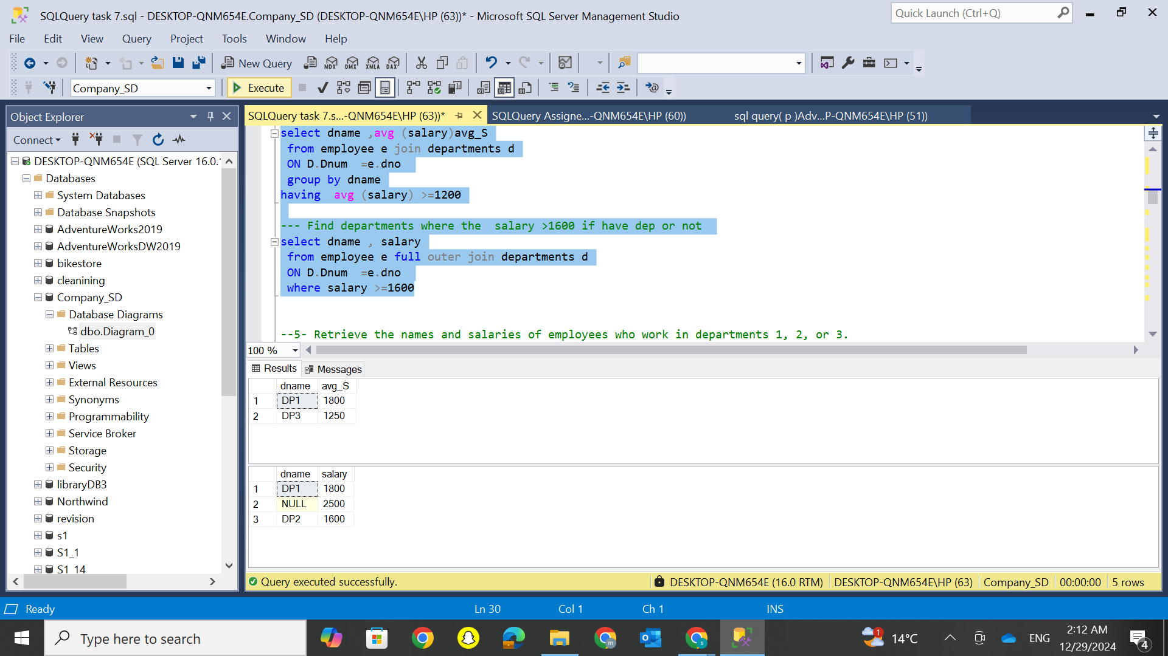
Analyzing Departments: Unique Names, Average Salaries, and High-Salary Thresholds

Slide 4
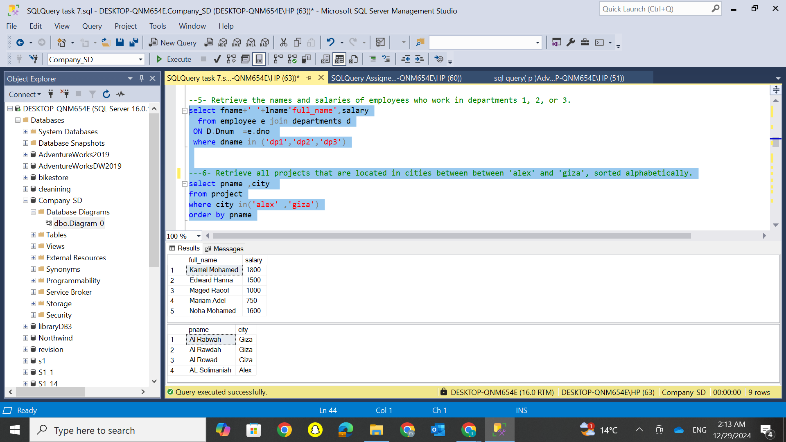
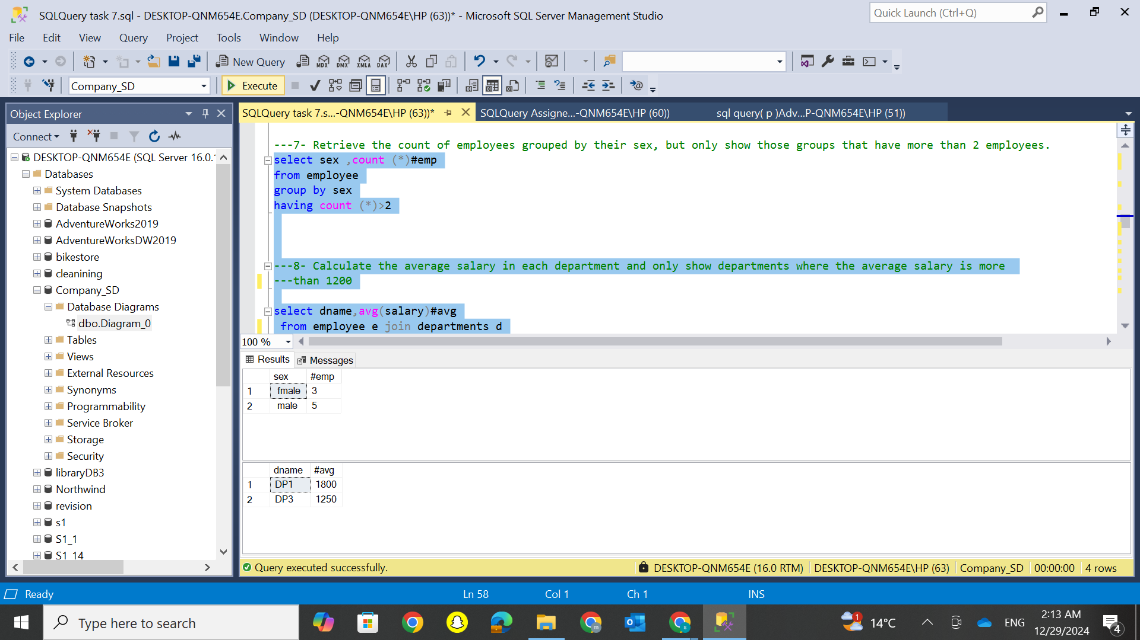
Comprehensive Analysis: Employee Data, Project Locations, and Salary Insights

Slide 5
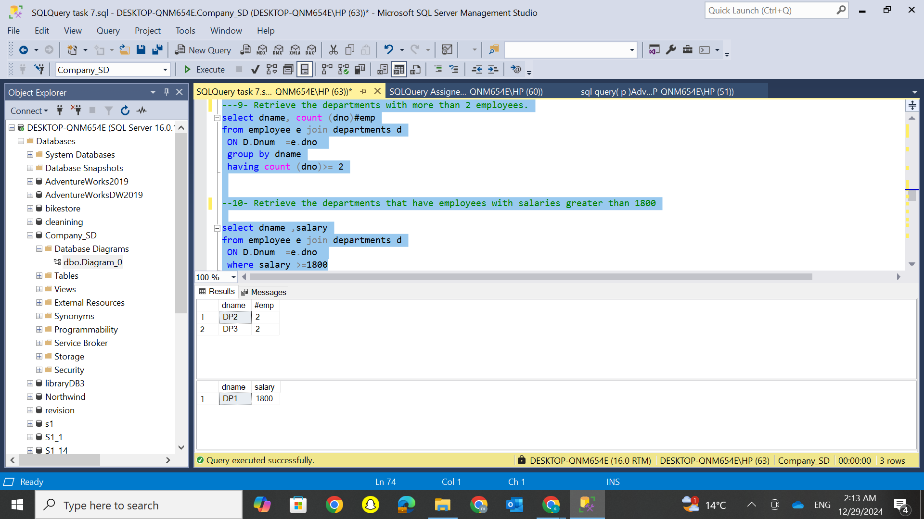
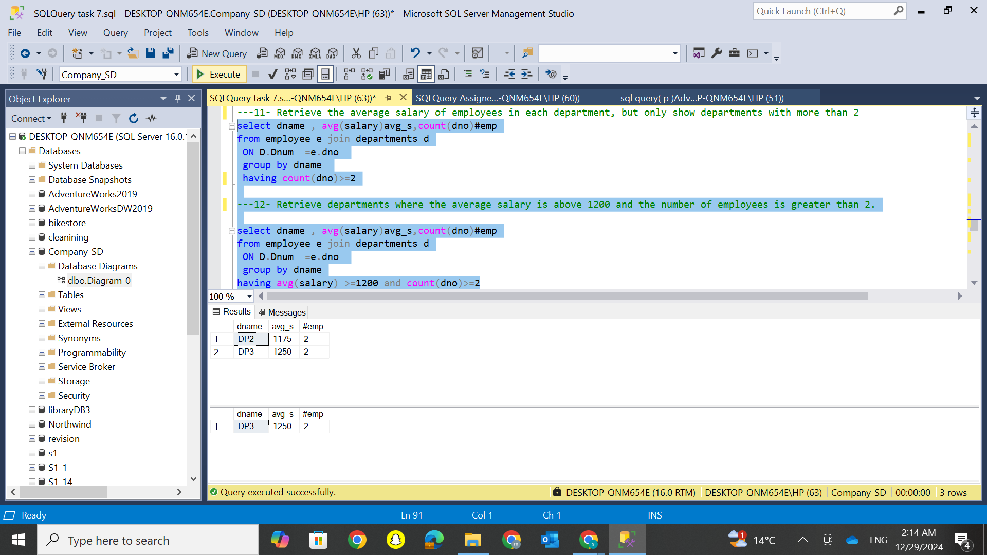
In-Depth Department Analysis: Employee Counts, High Salaries, and Average Salary Insights

Slide 6
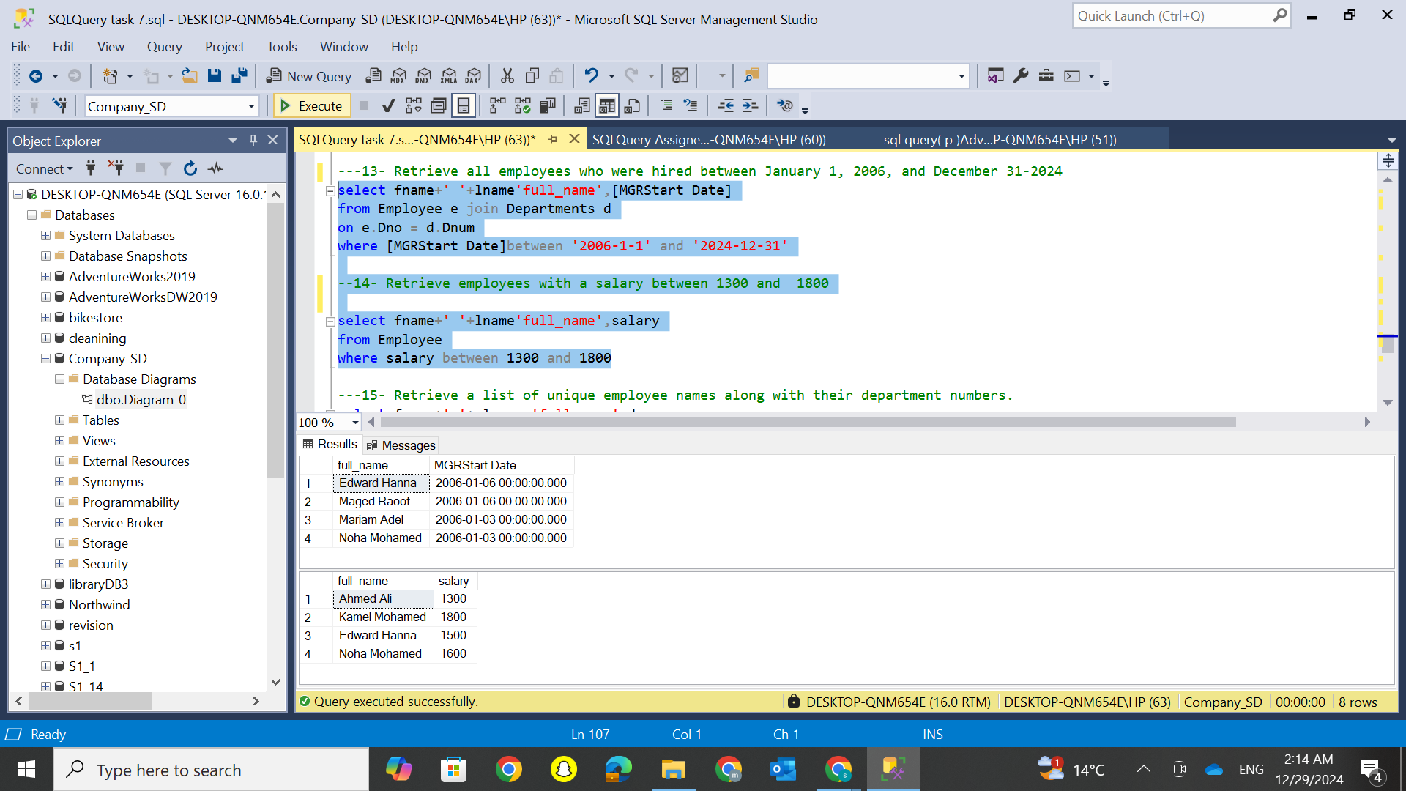
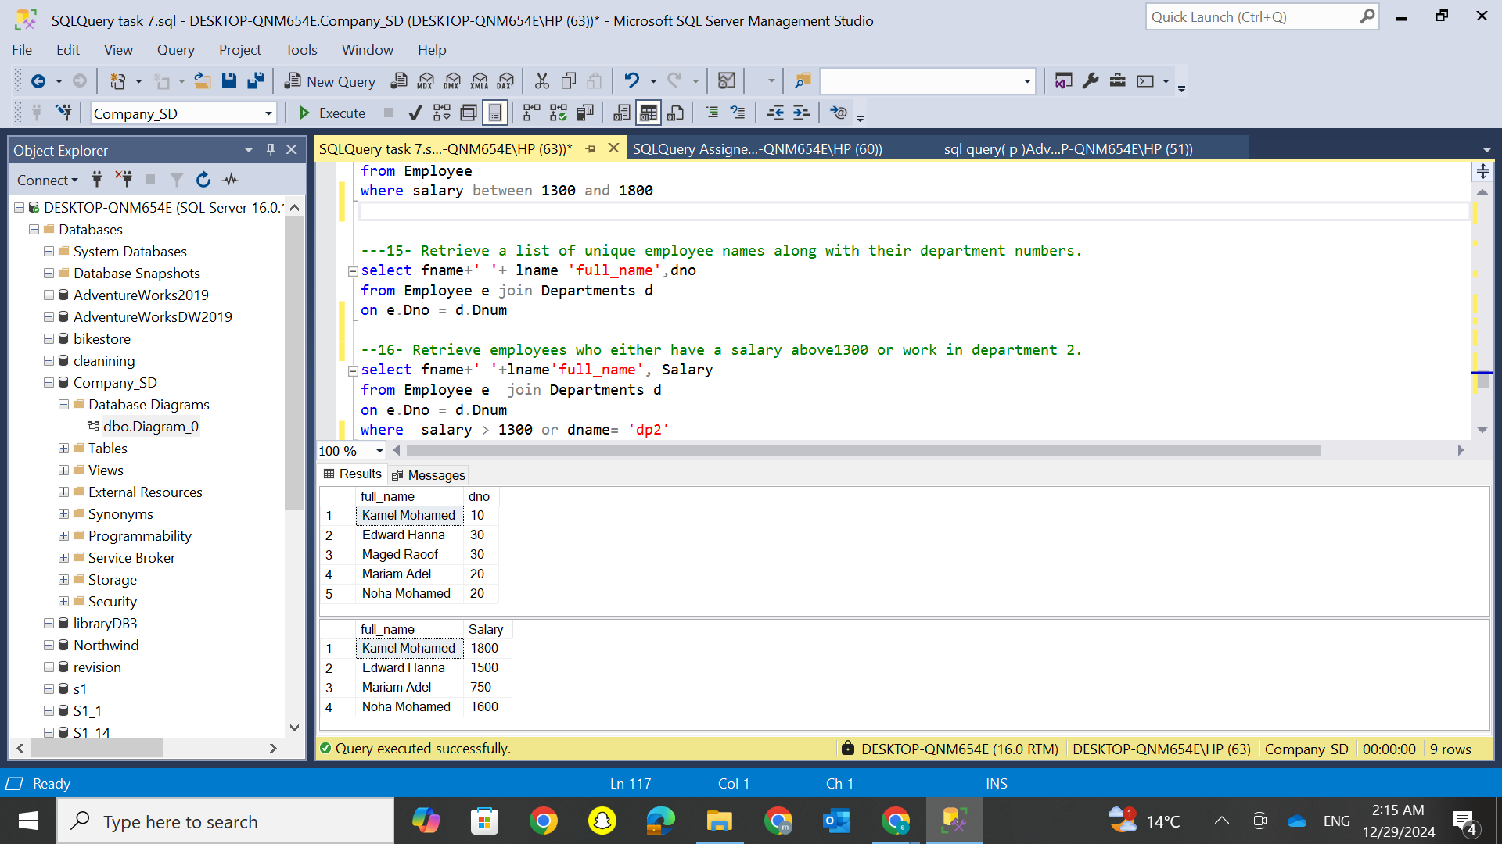
Employee Insights: Hiring Dates, Salary Ranges, and Departmental Data

Slide 7
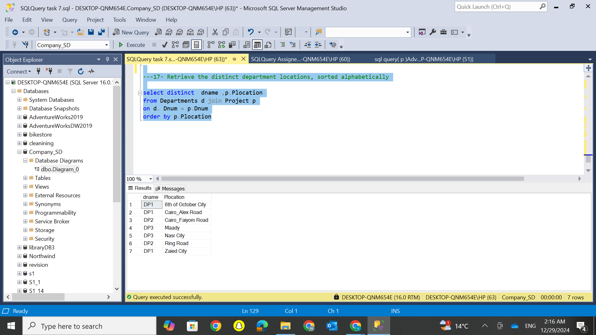
Department Analysis: Unique Locations and Alphabetical Sorting

Slide 8
Key insights
Departments name: DP1, DP2, DP3, DP4, DP6, DP7
Average salary for each department: DP1: 1800, DP2: 1175, DP3: 1250
Departments where the average salary is greater than 1200: DP1: 1800, DP3: 1250
Departments with more than 2 employees: DP2, DP3
Employees who were hired between January 1, 2006, and December 31, 2024: Edward Hanna, Maged Raoof, Mariam Adel, Noha Mohamed
Department locations: 6th of October City, Cairo_Alex Road, Cairo_Faiyom Road, Maadi, Nasr City, Ring Road, Zaied Cit

Slide 9
Thanks
Looking Forward to Your Feedback

